Slide 1
Bridging the Gap to Further Resilient, Sustainable, and Equitable Water Supply Planning
Waverly Klaw, Sustainability & Resiliency Manager, HDR
On behalf of Sonoran Institute Growing Water Smart Program
Presented to the Northwest Colorado Council of Governments Water Quality and Quantity Committee
November 15, 2024

Slide 2
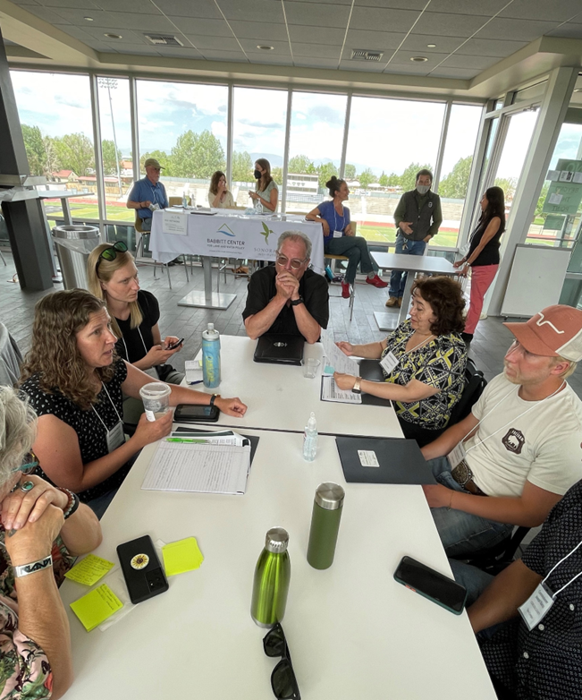
Growing Water Smart
Municipal Water Context
Warmer and drier climate reduces snowpack, stream flows, and total available water supply
90% of people live east of the continental divide, but 80% of precipitation falls west of it. CO’s water use is 90% agriculture, 7% municipal, 3% industrial.
Colorado communities are experiencing a growing gap between municipal water supply and demand and could need 230,000 - 740,000 acre-feet of additional water per year by 2050.
Growing Water Smart
GWS brings together community teams of planners, water managers, and elected officials during a 3-day workshop to discuss how they can better address water challenges through local plans, policies, and programs.
Reducing municipal water demand is a focus, but looking at the needs, challenges, and opportunities around municipal water supply planning is also important.
Notes:
Give some background context around why we are concerned with how communities plan for their water needs.
FIRST – our climate is changing, and it is impacting total available water.
SECOND – water is not readily available in places where it’s needed. And the bulk of water is used for agricultural purposes – which is very important!
THIRD – although miunicipal water use accounts for under 10% of water use in CO, there is a projected gap between water demand and water supply for our communities-

Slide 3
Timeline
Bridging the Gap
Dialogue project 2022-2023
Investigated impacts and outcomes from 5 historic water transfer projects
Resilient Water Supply Planning Capstone Report
Spring 2024; Corinne Anderson, MURP Student
Future Training and Resources
Building on GWS workshop
Deeper focus on enhanced water supply planning and regional cooperation
Interviewed 17 SMEs involved from all sides of the project (project proponent, sending community)
Project Goals: rethink water supply; collaborate regionally; understand how groups value water; prepare for uncertainty
Seeking input on interest in and applicability of tools
Project Outcome: report with 7 tools
Outcome: Report with key findings
Notes:
While Growing Water Smart focuses on reducing water demand through conservartion, efficiency, and strategic water use/reuse, Sonoran Institute has been exploring facets of the water supply planning and project side to ID opportunities to make it more resilient, sustainable, and equitable.
BtG: dialogue project with our partners NWCCOG QQ, Northern Water, Colorado River District and Trout Unlimited. Looked at 5 Historic water projects and ID'd set of findings (in the categories of Planning and Community Engagement, Permitting and negotiated agreements, stakeholder involvement, and project mitrigation).
Then were selected as a client for a MURP capstone project, where we worked with Corinne Anderson who had depth of experience on water supply planning side to conduct research and 1:1 interviews to look at tools to enhance water supply planning, collaborate regionally and prepare for uncertainty.
Working to hone resources and training opps on enhaned WS Planning, reporting out today and seeking some rapid feedback in a short amoutn of time.
BtG findings:
Planning and community engagement
Early and transparent long-range water supply planning and community engagement efforts led to better outcomes
Permitting and negotiated agreements
Imbalances in resources could create disparities among parties’ abilities to participate evenly in permitting, environmental review, or related negotiation
Stakeholder Involvement
Time and effort spent building trust and understanding differing perspectives and legal responsibilities, and shifts in organizational culture and attitude, can aid in reaching agreement during negotiations.
Project Mitigation
Mitigation measures and processes that adapt to on-the-ground realities after a project is constructed (which is referred to as “adaptive management”) can be an effective mitigation option designed to be flexible and responsive to real-time changes in the aquatic environment and a range of climate change scenarios
Some negotiations also addressing existing environmental degradation, often resulting from previously permitted water transfer projects. These important commitments (called “enhancements” in some negotiations) were integrated into federal and local permit conditions alongside mitigation commitments. Project mitigation should also address socioeconomic, land management, and other ancillary impacts from a proposed project.

Slide 4
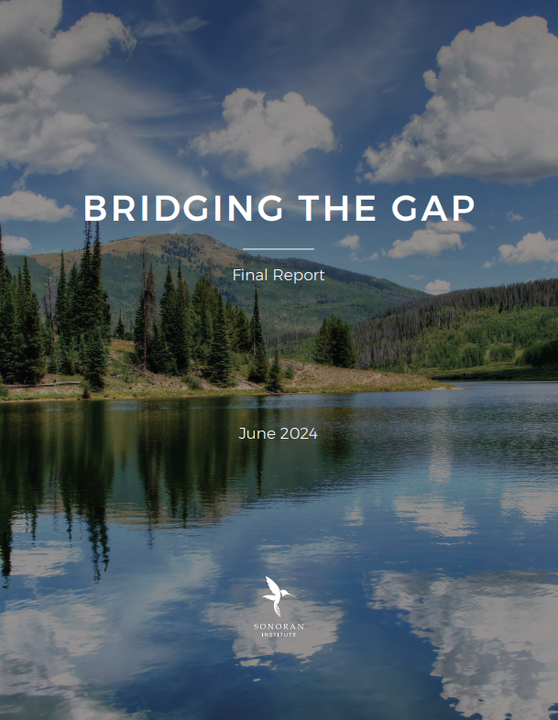
Bridging the Gap
“Bridging the Gap” is a project initiated by the Sonoran Institute and partner organizations that share an interest in avoiding or minimizing the negative impacts of water transfers. By gathering the experiences of key stakeholders from recent water transfer projects, we intend to bridge the gap in understanding between water suppliers investigating potential water transfers and communities that would be affected by such transfers to better highlight environmental and community challenges.
Report can be found at:
www.growingwatersmart.org → Colorado
Project Partners:

Slide 5
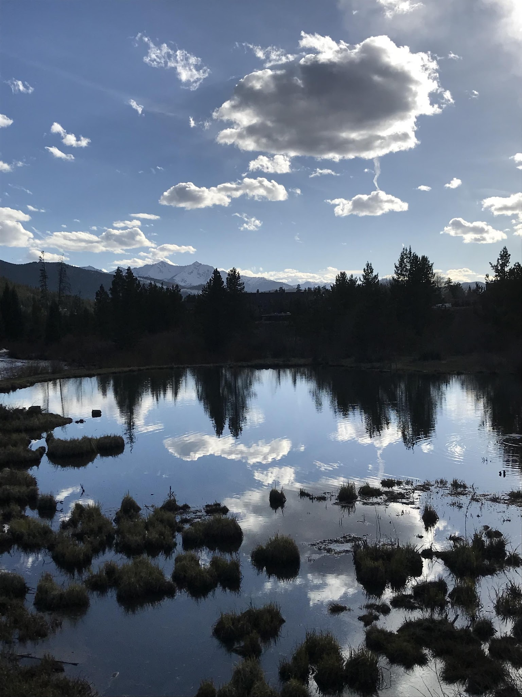
Bridging the Gap Focused on 5 Existing Water Projects
Windy Gap Firming Project
Moffat Collection System/ Gross Reservoir Expansion
Bessemer Ditch
Southern Delivery System
Thornton Northern Properties Stewardship Project
Projects are trans-basin, ag-to-urban, and reuse of trans-basin and ag-to-urban water
Notes:
These projects were chosen because they each involve, to varying degrees and at varying points in the history of the projects, the transfer of water from one river basin to another, or from one part of a river basin to another.
Trans-Mountain Diversion (Windy Gap Firming Project and Moffat Collection System/Gross Reservoir expansion.
projects involved agricultural to municipal transfers (Bessemer, Thornton NPSP)
The Southern Delivery System Project provides for the reuse of water already historically transferred from agricultural to municipal use and across the Continental Divide via transmountain diversion.

Slide 6
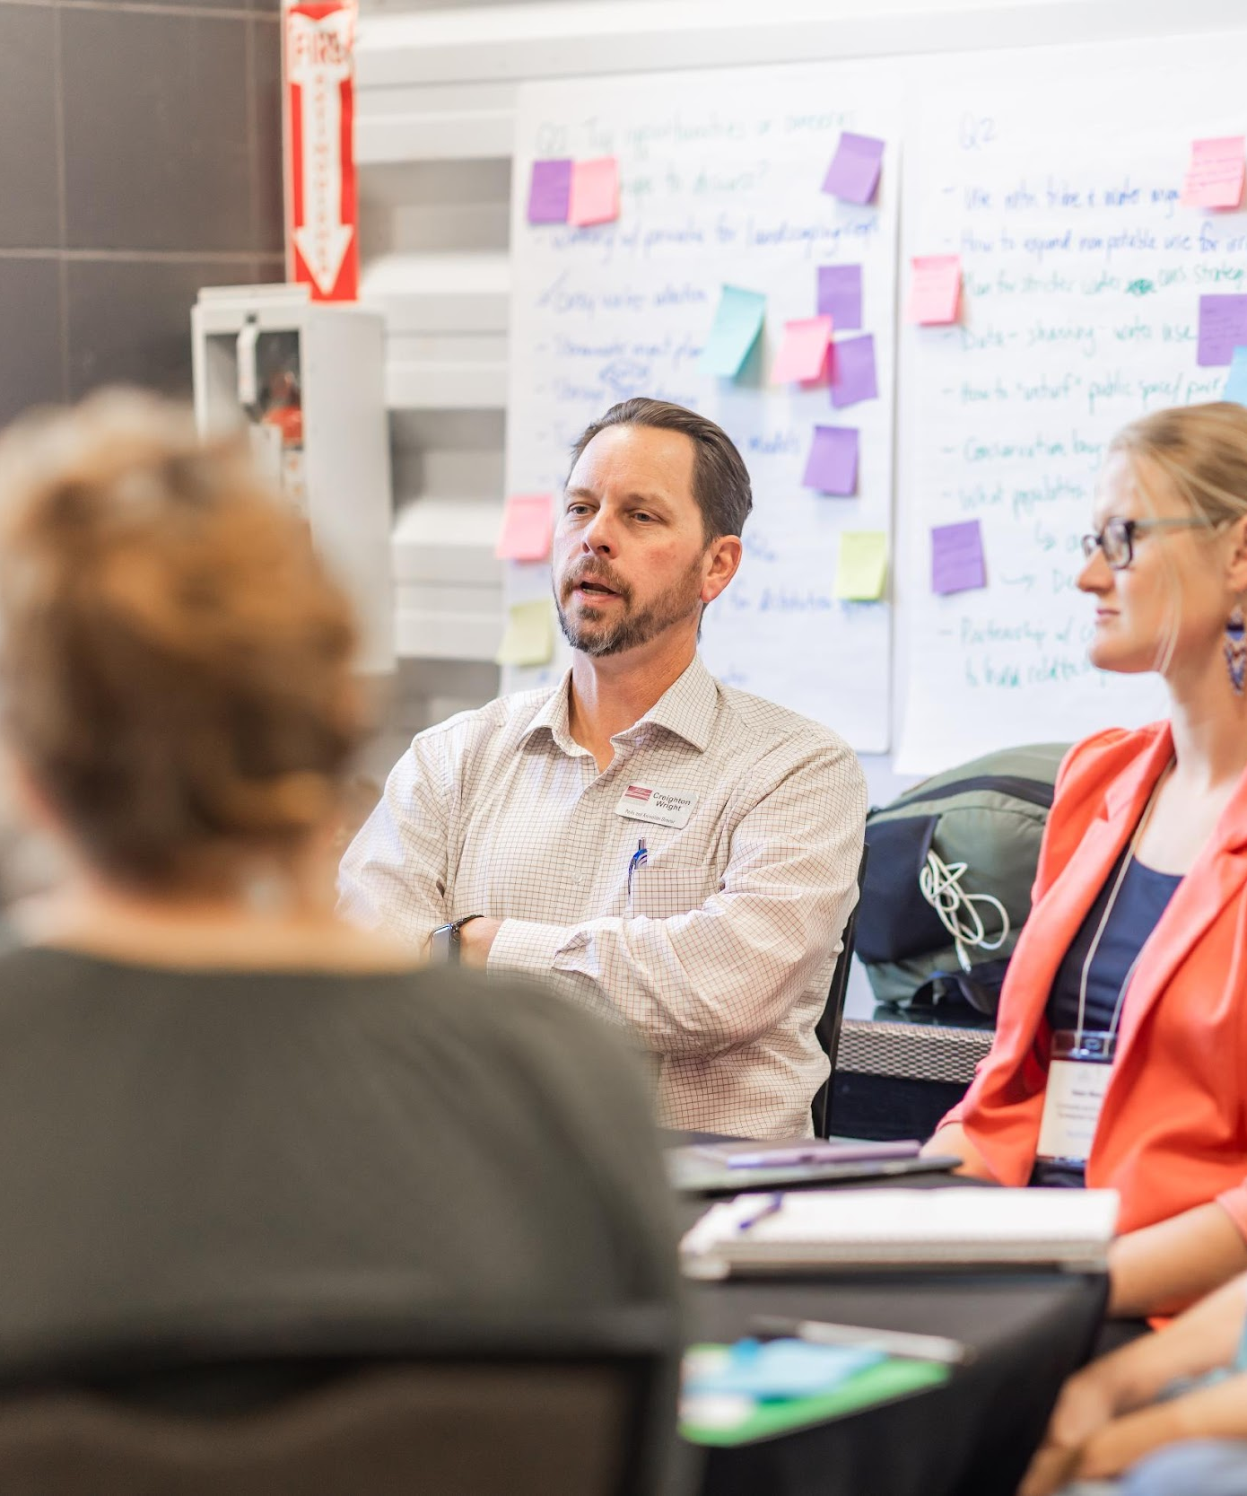
Bridging the Gap Dialogue Process
Interviews with stakeholders who had participated in the five projects to learn about project
Purpose
Processes (communications, negotiations, permitting)
Impacts (environmental, economic, social in sending area)
Mitigation (Learning by Doing participation, Colorado River Connectivity Channel, Environmental “enhancements,” alternative water management strategies for agricultural dry-up)
An initial convening of interviewees and subject matter experts to discuss common themes.
A second convening to review the findings in the final report.
Notes:
The dialogue process analyzed the five projects, which took place over 2 years, and captured the areas of agreement and disagreement, shaping the recommendations of the final report.
Brifely here is how the process was organized and executed.
Stakeholder Interviews
The first round consisted of 17 interviews conducted with diverse stakeholders, from water project proponents, planners, local governments, environmental groups, and agricultural interests.
We provided tailored questions that examined experiences with planning, permitting, and negotiations during the water transfer projects.
The goal was to examine interviewees’ past experiences with long-range planning processes that could lead to a water transfer project proposal and the complex permitting and negotiation processes once a project was proposed.
First Convening (April 29, 2022):
We then held our first convening, where interviewees (those who participated in the planning and execution of the project) and subject matter experts who discussed key findings from interviews.
Break-out groups prioritized key observations and identified points of agreement and disagreement.
Second Convening (June 6, 2023):
Review and discussion of the draft report.
Participants suggested updates, emphasized key findings, and recommended venues for sharing the report.

Slide 7
Selection of Key Findings
Planning and Community Engagement
Education and awareness raising is necessary to understand as part of whole portfolio of water supply strategies
Permitting and Negotiated Agreements
Disagreement around necessity for and efficacy of permitting processes to mitigate impacts
Disparity in resources available for negotiations created disparities between parties’ ability to participate evenly in permitting, environmental review, etc.
Stakeholder Involvement
Trust building is important for reaching agreement
Project Mitigation
“Adaptive management” allows for changes in mitigation approach due to future conditions
Early planning and engagement with affected communities or groups offers opportunities to shape project and mitigation strategies (or ultimately oppose)
Negotiated agreements (CRCA, Learning by Doing) could increase goodwill and lead to long term relationships and commitments
Shifts in organizational culture opened the door to deeper dialogue
During negotiations, coordination among and joint commenting from aligned parties or stakeholders can improve outcomes
Mitigating historic impacts as part of new mitigation measures helped improve environmental conditions
It can be challenging to address socio-economic impacts of water transfers if stakeholders are engaging as individual actors (farmers)
Long-range planning for both sending and receiving communities is needed to protect or conserve water resources and mitigate future conditions.
Notes:
Planning and Community Engagement:
1) Education and awareness raising is necessary to understand as part of whole portfolio of water supply strategies – i.e., reducing demand and water reuse.
2) Early planning and engagement with affected communities or groups offers opportunities to shape project and mitigation strategies before too late in the process (or after learning about the project stakeholders may ultimately oppose)
Long-range planning for both sending and receiving communities is needed to protect or conserve water resources and mitigate future conditions.
Permitting and Negotiated Agreements:
1) There was Disagreement among interviewees around necessity for and efficacy of permitting processes to mitigate impacts (sending communities found 1041 regulations to be highly valuable; project proponents felt regulations were applied without deep expertise)
2) Negotiated agreements could increase goodwill and lead to long term relationships and commitments and ongoing communication that ultimately led to better outcomes for all. Examples are the The Colorado River Cooperative Agreement (CRCA) between Denver Water and 26 west slope entities served to resolve several existing and potential legal issues in one large agreement. It also provided money and water to headwaters counties that have witnessed degradation of stream systems from historic out-of-basin diversions. The Grand County Learning By Doing Adaptive Management IGAs, executed by project proponents Northern Water and Denver Water and west slope parties, created a “cooperative, iterative and on-going process to maintain, and when reasonably possible, restore or enhance the aquatic environment in the Colorado, Fraser, and Williams For River Basins.”1
3) Disparity in resources available for negotiations created disparities between parties’ ability to participate evenly in permitting, environmental review, etc.
Stakeholder involvement
Trust building is important for reaching agreement – can be challenging during confidential negotiations.
Shift in or culture toward greater transparency and open discussions with stakeholders can lead to better outcomes for all parties and for the environment.
During negotiations, coordination among and joint commenting from aligned parties or stakeholders can improve outcomes, including recommended mitigation measures. For example, during permitting and negotiations for the Windy Gap Firming Project, Grand County, the Colorado River District, NWCCOG, and Trout Unlimited provided joint comments to federal agencies and project proponents whenever possible. Grand County also worked to coordinate all of the municipalities, special districts, and other interest groups in the County. This helped avoid the common challenge of addressing a myriad of stakeholders and disparate comments
Project Mitigation:
Mitigation measures and processes that adapt to on-the-ground realities after a project is constructed ( “adaptive management”) can be an effective mitigation option designed to be flexible and responsive to real-time changes in the aquatic environment and a range of climate change scenarios, as opposed to static mitigation measures based primarily on current predictions of future impacts.
Some negotiations related to proposed projects went beyond mitigating proposed project impacts to also addressing existing environmental degradation, often resulting from previously permitted water transfer projects (Windy Gap, Moffat, SDS). These important commitments (called “enhancements” in some negotiations) were integrated into federal and local permit conditions alongside mitigation commitments
Project mitigation should also address socioeconomic, land management, and other ancillary impacts from a proposed project. This can be particularly challenging if It can be challenging if stakeholders are engaging as individual actors (farmers) - when ag water rights re purchased from a willing agricultural property owner, neither the project proponent, the local government, nor the agricultural community is in a direct position to broker alternative transfer management approaches that could preserve the most productive agricultural lands and reduce economic impacts to the community resulting from shuttering operations.

Slide 8
Building on the Bridging the Gap Report
Foundational Insights from Bridging the Gap:
Impacts, challenges, and lessons from existing water transfer projects highlight the need for careful and transparent planning that emphasizes the importance of community engagement, trust-building, and stakeholder collaboration.
Shifting Toward Resilience:
Water supply planning must move beyond traditional methods, incorporating adaptive approaches that align with each community’s unique values and future uncertainties.
There is need for innovation and collaboration around how water is sourced, stored, and managed.
Building on Bridging the Gap
The next section describes how Sonoran Institute has built upon on these findings, researching and developing tools to help water providers and communities develop water supply systems and approaches that are more resilient, sustainable, and equitable.
Notes:
Have to plan carefully and transparently! Have to have meaningful community engagement and stakeholder collaboration to achieve better outcomes and eliminate or sig reduce negative impacts.
To really do this, water supply planning needs to incorporate adaptive approaches that account for and align with community and regional values and future uncertainties. Have to open up and make more interdisciplinary the process of planning for municipal water supply.

Slide 9
Capstone Research and Report
Corinne Anderson, MURP student at CU Denver, Spring 2024
16 one-on-one interviews, research about the history of water supply planning, the impacts of water transfers, and comparing available water supply plans.
Report that identified case studies of best practices and 7 tools that Colorado water providers use that could further resilient, sustainable, and equitable water supply planning.
Notes:
After hearing these observations from people intimately involved in the 5 projects studied in BtG, SI furthered its investigation into how communities can achieve more sustainable, resilient, and equitable water supply planning (and hopefully through that, develop solutions to water needs that are least impactful to environment, economy, and society across the state.
Corinne Anderson, MURP student at CU Denver, Spring 2024
16 one-on-one interviews, research about the history of water supply planning, the impacts of water transfers, and comparing available water supply plans.
Report that identified case studies of best practices and 7 tools that Colorado water providers use that could further resilient, sustainable, and equitable water supply planning.
Now want to: -Share findings from the SI's resilient water supply planning research with you
-Get your feedback on the applicability and feasibility of the seven toolboxes in the Resilient Planning Report

Slide 10
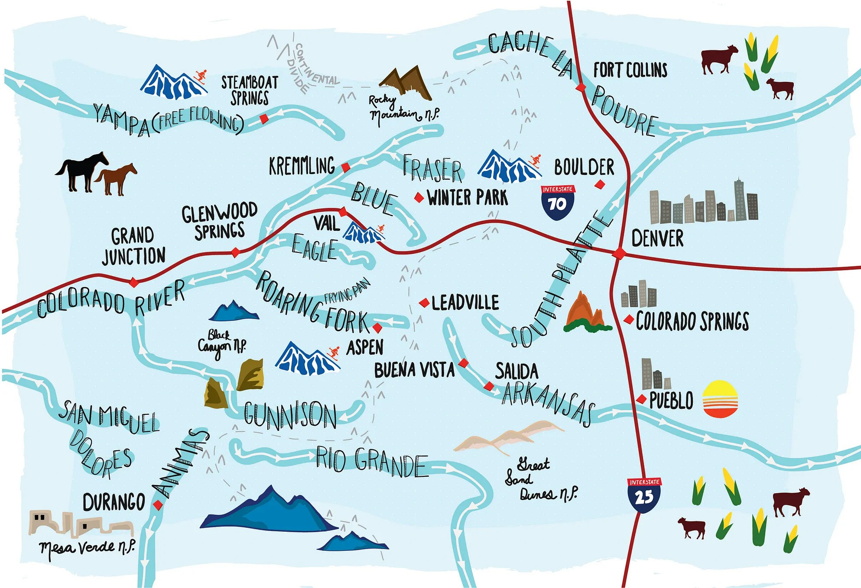
The Problem
Introduction
Water providers and the communities they serve need to start working toward resilient models that align with values and priorities unique to them while supporting a sustainable regional water system.
The fate of water in Colorado is closely connected to its population growth, economy, and culture.
Different communities have different levels of vulnerability to water scarcity.
Water supply and demand gaps already exist and are forecasted to increase.
Increasing water supply often involves the transfer of water, which has significant costs and impacts to communities in other parts of the state, to industries such as agriculture, and to ecosystems and recreational economies.
Planning for more resilient water supply, while often occurs locally, is a matter of regional, state, and national interest.
An illustration of the headwaters and water bodies in Colorado. Source: American Rivers
Notes:
Corinne’s problem statement was:
The fate of water in Colorado is closely connected to its population growth, economy, and culture.
Different communities have different levels of vulnerability to water scarcity.
Water supply and demand gaps already exist and are forecasted to increase.
Increasing water supply often involves the transfer of water, which has significant costs and impacts to communities in other parts of the state, to industries such as agriculture, and to ecosystems and recreational economies.
Planning for more resilient water supply, while often occurs locally, is a matter of regional, state, and national interest.

Slide 11
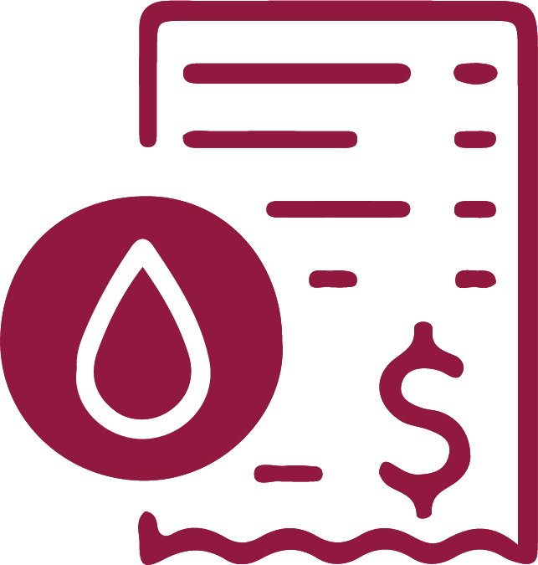
Resilient Planning
Water supply planning needs to shift toward using more adaptive and resilient methods that align with unique community values, priorities, and future conditions especially in the face of mounting uncertainty.
Recommendations
REGIONAL COLLABORATION & INFRASTRUCTURE SHARING
DIVERSIFY WATER SUPPLY PORTFOLIO
ADD & ENHANCE STORAGE CAPACITY
RIGHT-SIZE LAND USE PLANS FOR WATER AVAILABILITY
Sonoran Institute is looking for feedback on these toolboxes…. Please open the QR code and fill out the brief survey during this presentation (or after).
COMMUNICATE COST & COMPLEXITY OF WATER
SEEK INNOVATIVE APPROACHES TO REUSE
TRANSLATE COMMUNITY VALUES INTO WATER SUPPLY PLANNING
Notes:
These are listed in the order of frequency that Corinne heard these strategies mentioned. Some offer modifications to traditional approaches.

Slide 12
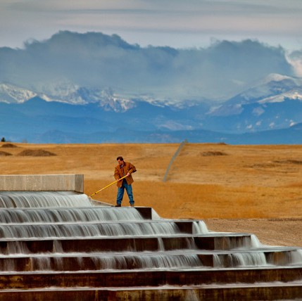
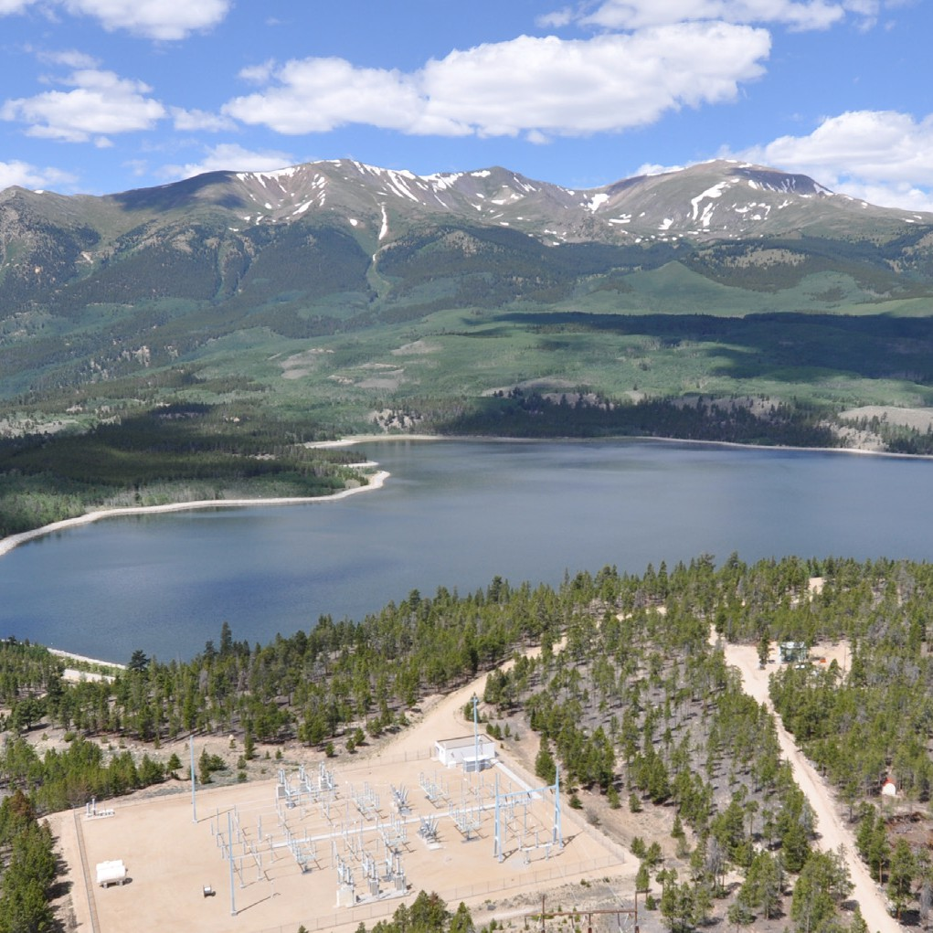
Regional Collaboration & Infrastructure Sharing
Start thinking regionally, and pursue projects that support watershed health, river flows, water reuse, and cost-sharing
Regional Planning and Decisionmaking
Interconnections and shared Infrastructure such as Reservoirs, Water or Wastewater Treatment Plants
Partnerships with Ditch and Irrigation Companies
Alignment on Drought Response Actions and Land Use Regulations
Watershed Health Partnerships
INFRASTRUCTURE SHARING THROUGH THE WISE PROJECT
UPPER ARKANSAS RIVER VOLUNTARY FLOW MANAGEMENT PROGRAM
CASE STUDY
Notes:
A lot can be said for the opportunities for regional collaboration – thinking regionally and pursuing projects to increase redundancy, cost share, support watershed health, and more
Examples:
Regional Planning: San Luis Valley 1041 IGA; Regional Planning Board
Interconnections and Shared Infrastructure: physical connections between two water systems. These connection points can be active at all times or only active when opened, such as during emergency situations. Greeley and Evans share water treatment. Shared reservoirs - split the cost of building or expanding a reservoir among different water providers proportional to the amount of storage they will have in the reservoir upon completion. Another way of sharing a reservoir is to lease storage space.
WISE: Thirteen entities, including Denver Water, established WISE, Water, Infrastructure and Supply Efficiency, as a regional partnership that provides new supply by combining unused capacities (storage space) in Aurora Water’s Prairie Waters Project with unused water supply from Denver and Aurora. During the years Denver and Aurora don’t need all of that water, and when excess capacity is available in Prairie Waters, 11 Douglas County entities that are part of the South Metro Water Supply Authority can buy the unused water to help reduce its reliance on nonrenewable groundwater.
Ditch partnerships: help improve and repair infrastructure in ditches and diversions in order to retain more water throughout the system by losing less to leaks and faulty hardware. Leasing non-potable shares for outdoor watering to ensure the water is being put to beneficial use.
Alignment on drought response and land use regs – reduce confusion and prevent pitting communities against one another in seeking investment and development.
Watershed health partnerships – looking at voluntary, coordinated releases of water from reservoirs when river flows fall too low for the ecology or recreational purposes. – upper Arkansas

Slide 13
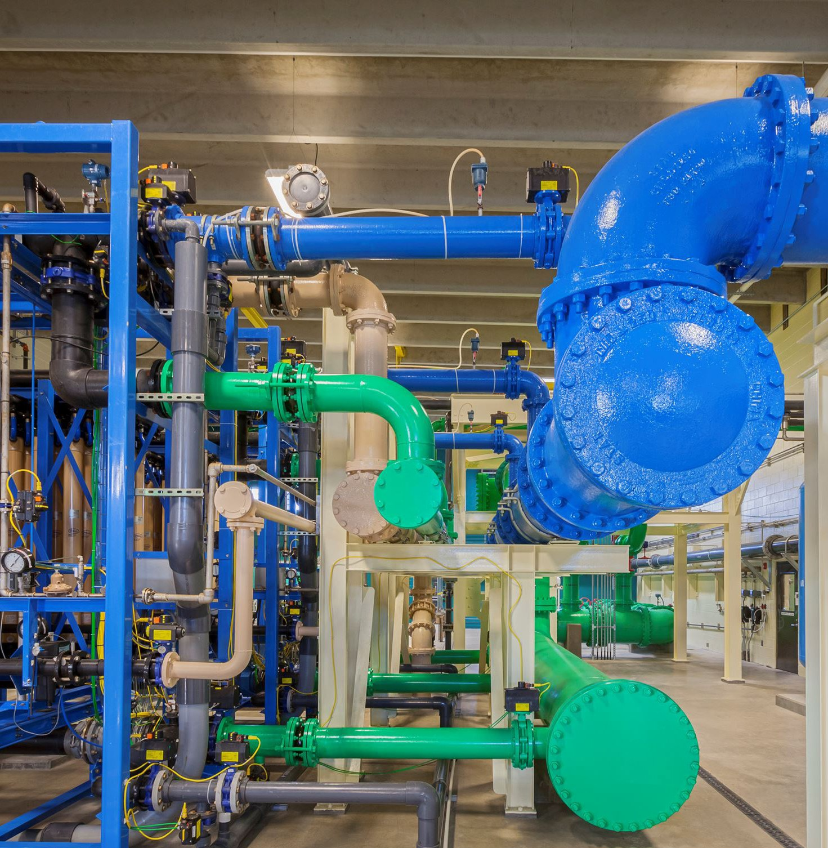
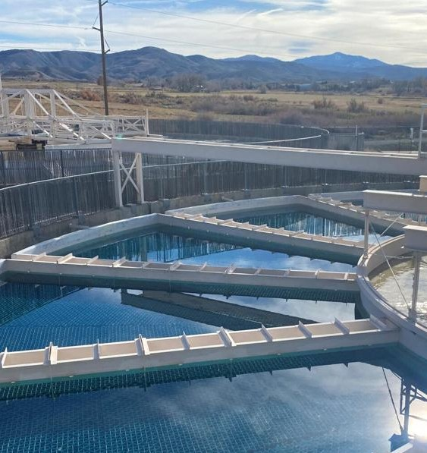
Diversify Water Supply Portfolio
Diversify water supply portfolios to ensure maximum resilience and reliability in the face of vulnerability from climate, cost, disruption, and emergencies
ACQUIRING A “RENEWABLE” WATER PORTFOLIO -- CASTLE ROCK, COLORADO
THE REGIONAL WATER RESILIENCY PROGRAM -- PROJECT 7 WATER AUTHORITY
Risks of Centralization | Rewards of Diversification
- Impacts of wildfires on watersheds and water storage | + Provide redundancy
- Disruptions from infrastructure damage | + Utilize “right water for right use”
- Prolonged drought impacts single supply | + Move from non-renewable to renewable water
CASE STUDY
Notes:
This tool is very resilience-centered, focuses on diversification – not relying solely on non-renewable groundwater or on surface water from a single source like the Colorado River. Seeking a broad portfolio of water sources in order to reduce impacts of one source becoming impaired or unavailable (groundwater depletion, impacts of wildfires on watersheds and water storage (hayman fire for Denver Water, East troublesome fire for Northern Water 2020,
disruptions when infrastructure is damaged, prolonged drought...by relying on varied sources of water, adding redundancy to the system, and considering the right water for the right use.
Castle Rock intentionally setting goal to move away from Groundwater and in 2006 set a goal of having a 75% renewable water portfolio by 2050, and 100% by 2065.
Project 7 Water Authority was dependent on the Gunnison River, one treatment plant and one transmission line. Now a new water supply will be provided from the Uncompahfre River via the Ridgway reservoir. – new treatment plant and new ability to access existing water rights.

Slide 14
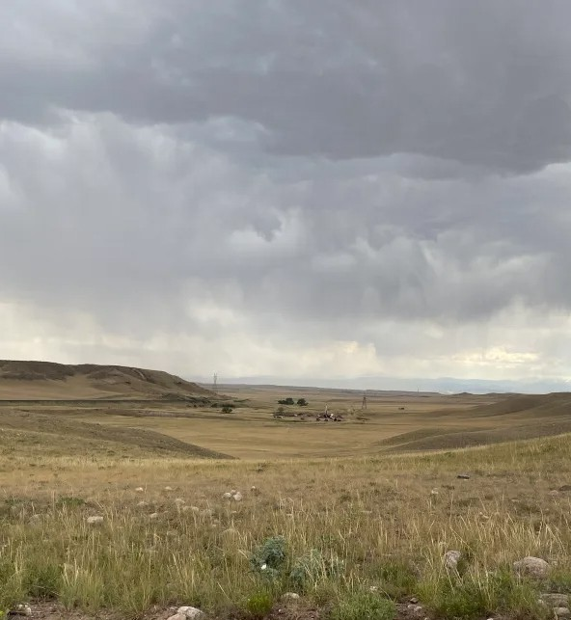
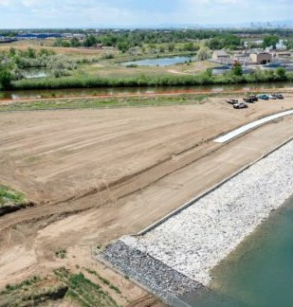
Add & Enhance Storage Capacity
Explore ways to add and enhance water storage capacity to fully support the existing water supplies available, and potentially find co-benefits to the storage options.
Colorado Water Plan includes thoughtful water storage solutions as a tool to address water issues and meet needs of state
Develop multi-purpose projects that have added benefits, such as ecological or recreational
Look for more innovative and less impactful storage ideas such as aquifer storage and recovery and gravel pits
Considering how to prevent evaporative losses by using creative solutions such as reservoir covers and solar panels
GRAVEL PIT STORAGE AND EXCHANGES -- FRONT RANGE
CASE STUDY
CASE STUDY
TERRY RANCH AQUIFER STORAGE -- CITY OF GREELEY
Notes:
Get more creative on storage -
Cities like Greeley, Castle Rock, and water providers in Arizona and California are pursuing aquifer storage and recovery (injecting water into aquifers during wet years to access again when needed). Other alternatives that are being considered include reducing evaporative losses from storage by protecting surface reservoirs with small plastic balls, modular dam or reservoir covers, and even solar panels to shade the reservoir from intense sun and heat.
Thinking about multi-purpose projects and more flexible water storage ideas such as repurposing gravel pits from mining into water storage.
Question? How many in the room think their communities have sufficient storage? If so, are there ways that storage could be optimized? How many are looking for additional storage opportunities?

Slide 15
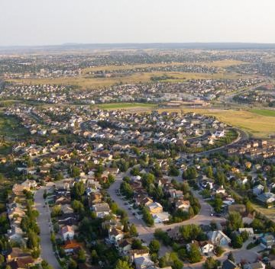
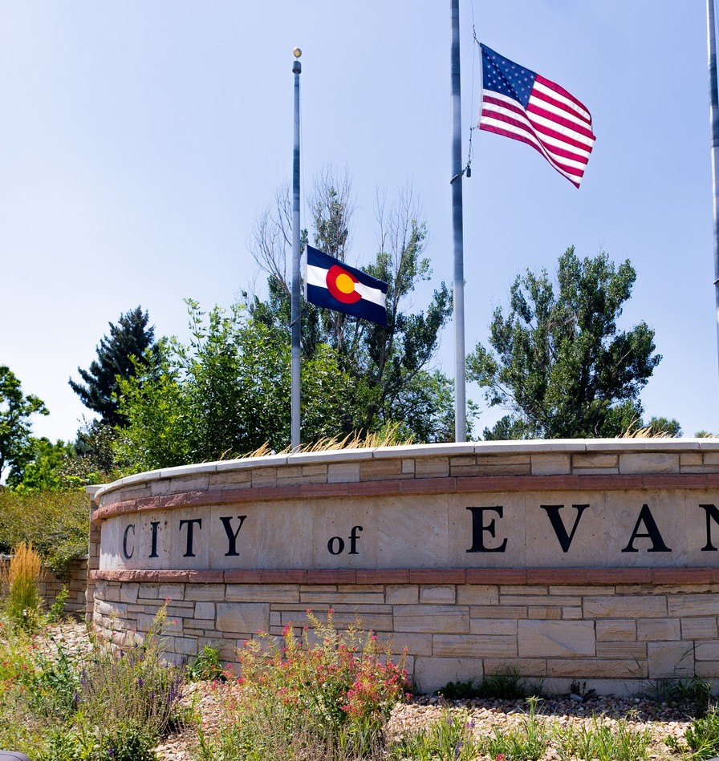
Right-Size Land Use Plans for Water Availability
Work together with land use planners to identify ways to right-size development, especially in growing urban areas, with water availability, rather than guaranteeing water service to any new development that emerges
Water availability should help inform land use plans and future growth areas
Sharing/shared land use and infrastructure maps between water resources and planning departments can better plan for water demand by land use type
Tier water tap fees and dedication requirements based on water efficiency rather than acreage
Counties and municipalities can specify water sufficiency requirements for new developments
USING LAND USE CATEGORIES FOR PROJECTING FUTURE GROWTH AND WATER USE -- CITY OF COLORADO SPRINGS
REQUIRING NON-POTABLE SYSTEMS IN NEW DEVELOPMENTS -- CITY OF EVANS
CASE STUDY
CASE STUDY
Notes:
These discussions are happening at GWS. Anyone want to share anything they have recently implemented or are thinking about at the workshop to support the two-way communication between water availability and plans for growth?

Slide 16
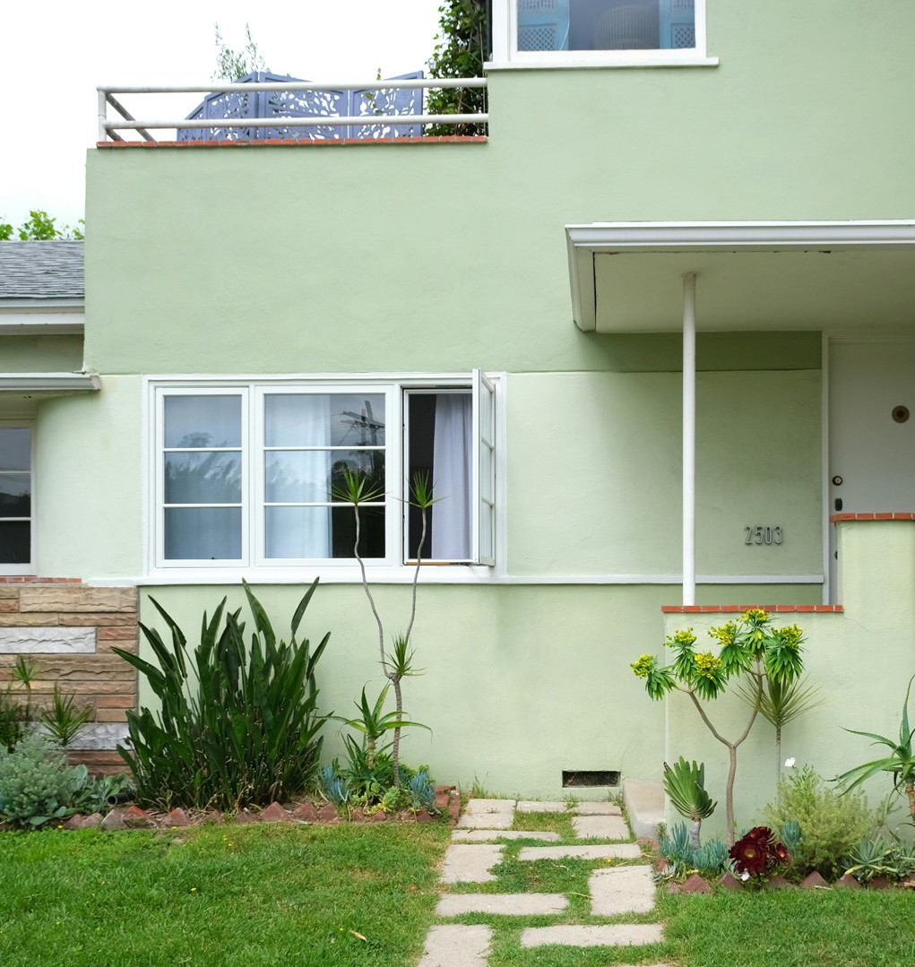
Seek Innovative Approaches to Reuse
Find the best ways to reuse any fully consumable water supplies available and seek out partnerships with other water providers that have supplies to trade or lease
Direct Potable Reuse
Indirect Potable Reuse
Greywater Recycling
Non-Potable Water Recycling
Stormwater Capture and Reuse
Exchanges
LAUNDRY TO LANDSCAPES -- GOLDEN
CASE STUDY
Notes:
Using every drop of legally consumable water as many times as possible before it moves downstream.
A range of approaches to water reuse:
Direct Potable Reuse: transforming treated wastewater into a safe, reliable drinking water supply through multiple phases of advanced water purification.
Indirect Potable Reuse: using an environmental buffer, such as a lake, stream, or groundwater aquifer, to store reusable water until it is treated again at a treatment facility.
Greywater Recycling: the reuse of household water from sinks, showers, washing machines, and dishwashers that does not contain serious contaminants (as from toilets) for toilet flushing or watering landscapes
Non-Potable Water Recycling: transforming treated wastewater to standards acceptable for irrigation or industrial purposes but not for drinking water.
Stormwater Capture and Reuse: collecting stormwater and rainwater to reuse directly for irrigation or to allow it to infiltrate into groundwater basins for future use.
Exchanges: Water exchanges are the transfer of water between two different water supply or storage facilities. These transfers can be done with several entities, or within one entity’s holdings. Exchanges do not create additional water, but instead improve the timing, efficiency and allocation of water supplies by moving the water to where it is needed most or overcoming geographical constraints.

Slide 17
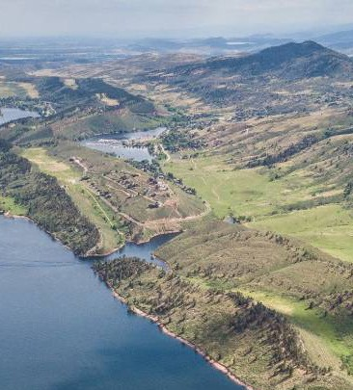
Communicate the Cost & Complexity of Water
Communicate the cost and complexity of water so that residents become water literate and can more effectively convey their priorities and values around how and where their water comes from
Enhance sophistication and awareness about where water comes from and what it takes to reach their tap
Broad range of information available from water providers about their water supply portfolio
Share cost information, such as cost of treatment and distribution per acre-foot, online or in water bills to customers
Offer public educational tours of water treatment facilities to strengthen public awareness
LARIMER COUNTY WATER MASTER PLAN
CASE STUDY
Notes:
Not just literacy for the sake of it, but to then involve residents in setting priorities and being part of the solution. = community champions for the hard decisions.
County-level water master plans:
help break down siloes between planning departments and water resources staff
develop One Water ethos

Slide 18
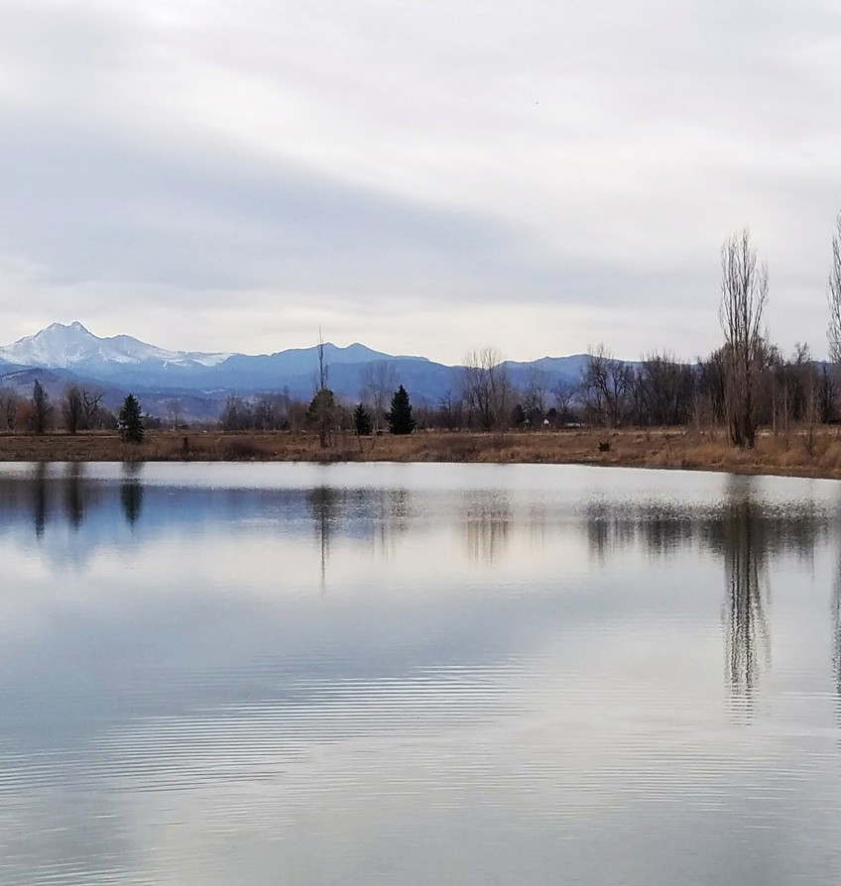
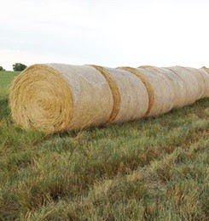
Translate Community Values into Planning Approaches
Use community and regional values around environment, economy, and industry as guideposts for water supply planning, projects, and programs.
Establish policies that govern water supply projects that align with community values of water
Community engagement in water supply and efficiency plans
Annual surveys of water customers to gauge feedback on water supply projects
Learn about community members’ values and connections to water and get involved in local efforts related to water (art, culture, advocacy, etc.)
Weigh the impacts of water transfers and develop partnerships, community-driven solutions, and CWSAs
GUIDING WATER PRINCIPLES -- LONGMONT
THE NORTHERN PROPERTIES STEWARDSHIP PLAN -- THORNTON
THE NORTHERN PROPERTIES STEWARDSHIP PLAN -- THORNTON
CASE STUDY
CASE STUDY
Notes:
Goes hand in hand with communicating cost and complexity of water.
Develop Policies and Principles that align with community and regional values around water.
Statement of Goal Policy Statement
Goal 1 The City will acquire and maintain a raw water supply sufficient to meet the water demands of the City at full build-out of the Longmont Planning Area during a drought with a 1 in 100 year recurrence interval. The City will maintain diligence on conditional water supply projects. The City will continue to meet its Raw Water Quality of Life Benchmark. The City will continue to pursue efforts to maintain and improve the yields of its water rights and interests in regional water projects.
Goal 2 The City will maintain and enforce a Raw Water Requirement Policy that is consistent with other polices adopted by the city, and that support the attainment of the other goals stated in this document. The City will continue to consistently apply the Raw Water Requirement Policy to all new development in the City. The City will continue to revise the Raw Water Policy as necessary to meet the water supply needs of the City.
Goal 3 The City will acquire, develop, and beneficially use a water supply that consists of water rights in the South Platte and Colorado River basins. The City’s water supply will continue to be composed approximately one-third from the Colorado Big Thompson and Windy Gap projects with the balance from St. Vrain and Left Hand basin water rights.
Goal 4 The City will pursue policies that develop and maintain a high quality raw water supply for delivery to treatment facilities either directly or by exchange. The City will place highest priority on development and maintenance of water originating in high mountain watersheds, and the storage of that water in mountain reservoirs. The City will integrate other sources of supply, giving highest priority to exchanges. The integration of such supplies into the treatment system will take place as demand requires and when technology of treatment evolves to allow for high quality potable water at reasonable treatment costs.
Goal 5 The City will pursue policies that promote the retention and preservation of water supplies that originate in the St Vrain Basin for use within the St. Vrain Valley. The City will work cooperatively with the St. Vrain and Left Hand Water Conservancy District and local irrigation companies and water districts to develop and implement strategies that result in the preservation, retention, and use of native water supplies.
Goal 6 The City will pursue policies that will protect and improve the quality of the water supplies in the St. Vrain Creek watershed. The City will continue to develop and implement watershed protection programs, actively participate in implementing projects and programs that improve the water quality of storm water discharges, and discharges from the Wastewater Treatment Plant that are within the Total Maximum Daily Loading of the St. Vrain Creek.
Goal 7 The City will develop and implement a water conservation policy that strives to achieve a sustainable use of its water resources. The City will strive to achieve water conservation that results in water demands at build out of the Longmont Planning Area that are 10 percent lower than current projections. The City will pursue water development that does not rely on the dry up of agricultural lands.
Goal 8 The City will pursue water policies and operations that minimize adverse environmental impacts. The City will independently and in partnership with other agencies and organizations evaluate the environmental impacts of water development projects and operate the City’s water resource facilities to minimize adverse environmental impacts while not unreasonably diminishing the yield of the City’s water supplies.
Goal 9 The City will pursue water policies and operations that promote multiple uses of water. The City will manage its water resources with the primary goal of meeting the domestic water needs of its customers while also striving to provide for other water uses such as recreational, agricultural, and environmental.
Goal 10 The City will develop a strategy of flexibility in raw water supply that will enable it to respond to changes in supply and demand conditions. The City will continue to acquire, develop and operate its water supply to provide for the necessary redundancy, flexibility and capacities to address potential changes in climate, system and operational failures, and changes in water demands while maintaining a reliable water supply.
Goal 11 The City will consider regional supply and treatment partnerships and agreements that complement and support other regional goals of the City and clearly benefit the citizens of Longmont. The Longmont Municipal Charter, Section 11.1, allows the City to provide extraterritorial water service provided the agreements or contracts clearly benefit the inhabitants of the City.
Goal 12 The City will develop strategies to meet the above goals in the most economically beneficially manner for the citizens of Longmont. The City will continue to evaluate the costs and benefits of all water development strategies and seek to meet the water needs of the community using favorable financing options, encouraging water conservation, efficient project designs, and partnering in regional water projects where appropriate

Slide 19
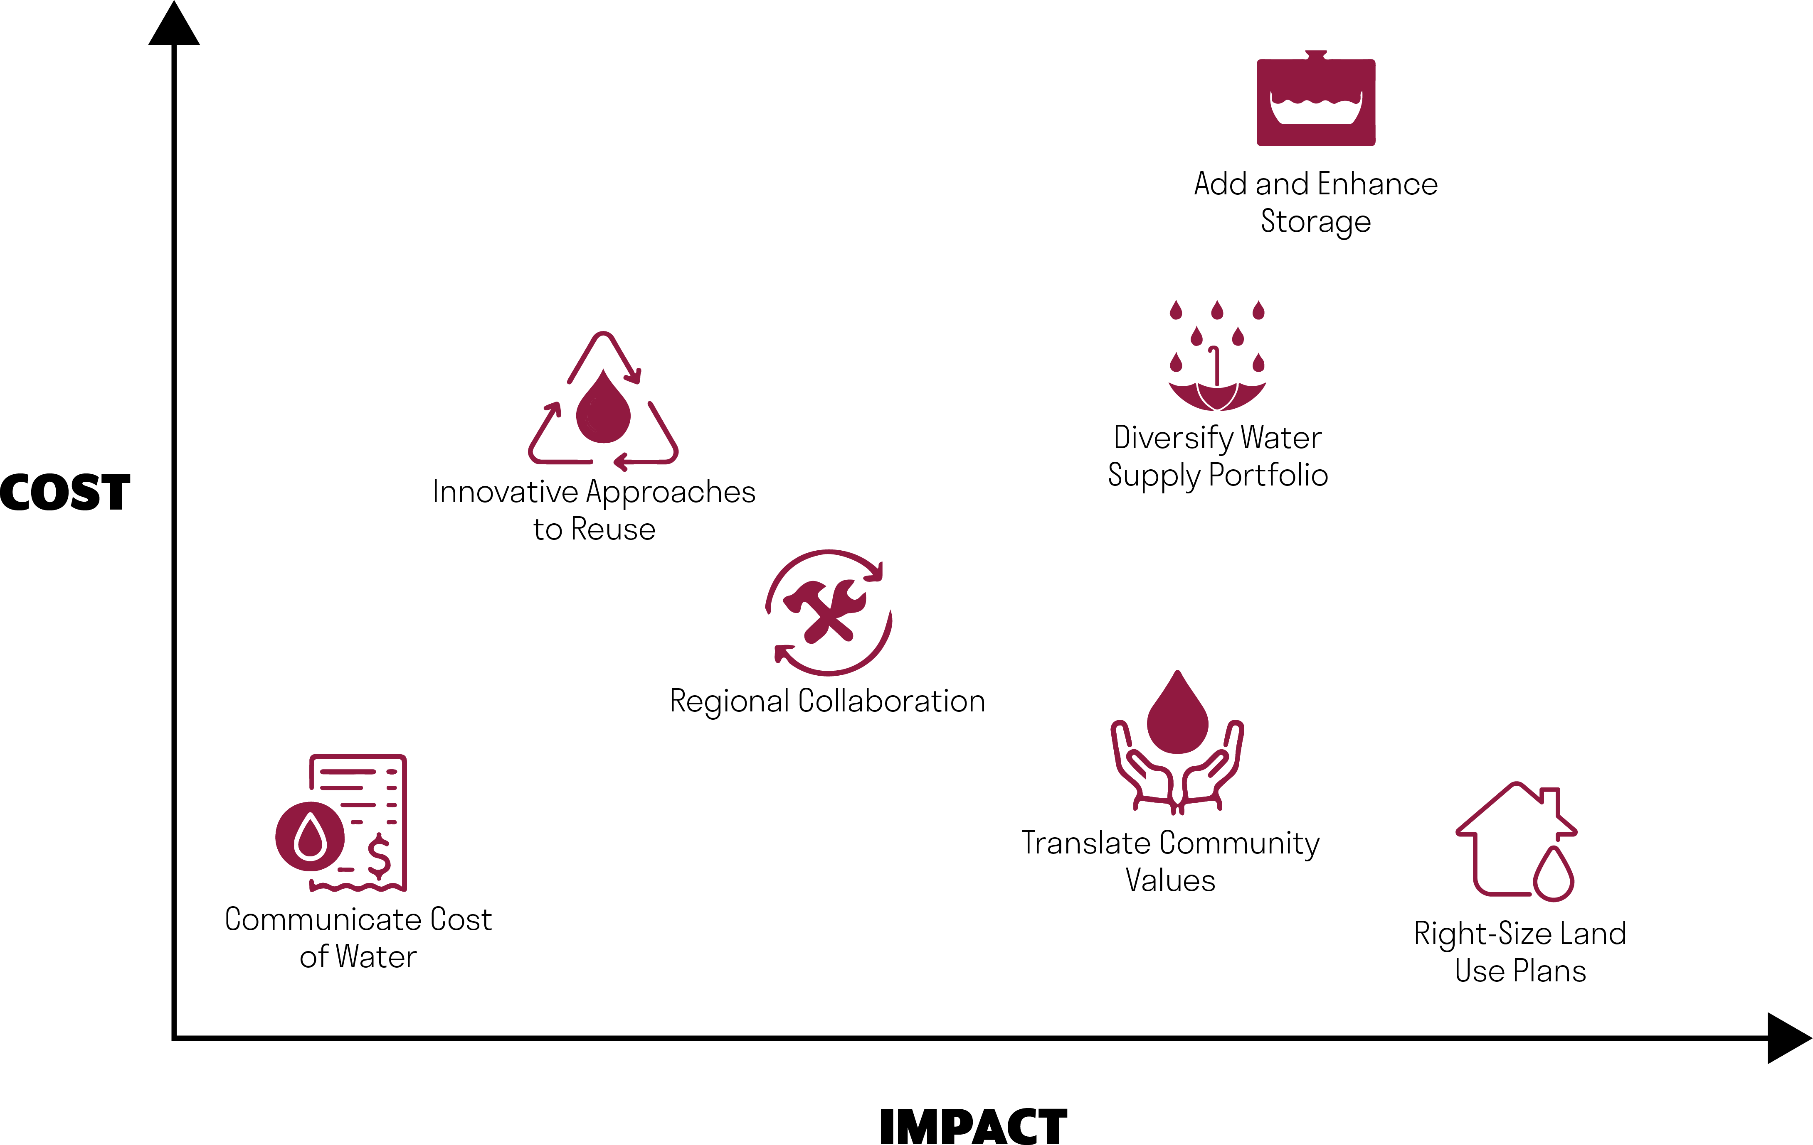

Slide 20
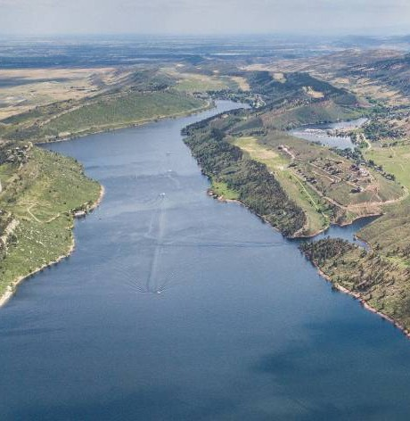
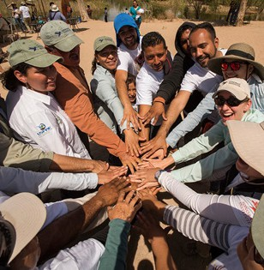
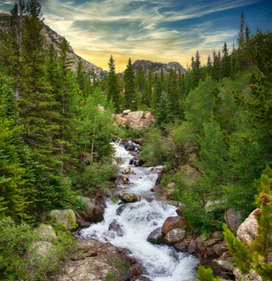
Discussion
Changes to water supply planning are likely going to be difficult and more complex than existing demand management strategies, but will be necessary in the face of climate change, growing populations, and increasing water scarcity.
What strategies should be added to the list to promote resilient, sustainable, and equitable water supply planning & water resource management?
Would training and resources on this topic benefit your community?
What barriers do you see to getting to more resilient, sustainable, equitable water supply planning?
Who else should we meet with and learn from?
Notes:
Potential discussion questions:
Which toolbox is most interesting to you and your community? (Meryl can call out someone who raised their hand for one of the tools earlier to get the conversation going if needed)
Does your community have a water supply planning project that uses any of these approaches that you can share?
Are your communities relying on new water supply projects as part of your future water supply and demand balance? If so, how are you incorporating community involvement, where you do and don’t want to get water from, other metrics and goals shared during this presentation?

Slide 21
Thank You!
Contact Information:
Waverly Klaw
waverly.klaw@hdrinc.com
Meryl Corbin
mcorbin@sonoraninstitute.org

